Slide 1
Welcoming Instructions
For all Attendees of the 2024 HBPA BC AGM
Please note that all attendees upon entry, will be put on mute, and muting will be controlled by the meeting moderator. You are encouraged to leave your camera on.
Use Chat (in the Zoom app) to type a question for the moderator to relay to the presenter(s) at that time or at the end of the meeting, whichever makes the most sense.
Notes:
Introductory message for all participants.
The hosts screen was shared and the shared screen was limited to these slides.

Slide 2
Horsemen’s Benevolent and Protective Association of BC
2024 Annual General Meeting
7:00 PM via Zoom
November 21, 2024
Notes:
Attendees were walked through the presentation. Neil Stajkowski and Denise Praill moderated. Denise watched the chat for all questions. Questions were either provided to the presenter while in the topic or they were kept until the end of the presentation during the Q&A time. David Milburn was also present.
Formal minutes of the meeting will be prepared and the presentation will form part of the minutes.

Slide 3
Meeting Agenda
Call to Order, Quorum, and Introduction of Current and Newly Elected Directors – David Milburn
Approval of Minutes of the meeting held April 20, 2024 – posted at www.hbpabc.ca – Neil Stajkowski, Secretary-Treasurer
Approval and Review of the March 31, 2024, HBPA BC financial statements – posted at www.hbpabc.ca - Neil
Approval of auditors for the March 31, 2025, HBPA BC financial statements – Neil
Industry Financial Report, 2024 Meet – Neil
President’s Report – David
BC Racebook (Teletheatre BC) Report – TBC Board Chair – Gary Johnson
Notes:
Agenda was presented to all by Neil Stajkowski

Slide 4
Meeting Agenda – continued
On-Going and Future Racing Matters and Issues:
  Lobbyist Work – Gary
  Government Relations – Gary
  Hastings Site Lease – David
  Feedstore – Neil/Mel Snow
  2025 Meet Details – Neil/David (This will include Race Dates, vaccinations, feed storage, stall applications and other general information for discussion)
Questions and Other Business
Adjournment

Slide 5
Call to Order
David Milburn to:
Introduce Directors included newly elected
Determine that a Quorum (minimum 25 members) is present
Call the meeting to order
Record time _________
Notes:
Meeting was started as a Quorum of at least 25 members – 55 were online at its max – were present and so President Milburn began the meeting in proper.
Meeting began at 7:08
David introduced newly elected Board members – Chris Ceraldi, Jordan Froelich, Mark Freeman and John Snow
David thanked former Board members for their service over the past 3 years, minimum – Don Danard, Richard Hamel, Tara Niegel and Patty Leaney
David also asked for a minute of silence to respect the passing of Dairen Edwards – then President of CTHS BC and Owner of the year in 2023 and 2024 as principal of Willow Creek Farms who passed away suddenly very recently. He also wanted to acknowledge the passing of Darlene Smith, a long-time super fan and owner of thoroughbreds, huge friend of the backstretch and regular at the gap watching training etc. Who recently passed after a long illness.

Slide 6
Minutes for Approval
Minutes of the 2023 Annual General Meeting held on April 20, 2024, for Approval
Motion:
Moved (________), seconded (__________) to approve the minutes as distributed.
Any errors/omissions/corrections?
Call the Question:
Notes:
Neil presented the minutes of the 2023 AGM held in April 2024.
There were no errors or omissions noted, and they were moved by Craig MacPherson and seconded by Nigel Reid.
Carried

Slide 7

March 31, 2024, Financial Statements
Highlights
Feedstore – fewer horses mean lower sales, less inventory and smaller bottom line for HBPA programs. Net down $40k but no bag fee applied at all in for the period.
Overall, Balance Sheet is basically unchanged from previous year.
Revenues: $181,750 from industry, some interest, $30k from feedstore and use of deferred revenue $38k for direct programs
Key Expenditures:
  Contractors – 4 for administration, communications, Acctg and learning centre totalling $101k
  Benevolence and Dental - $25k
  Jockey recruitment and related expenses - $14k
  Lobbyist work - $9k
Notes:
Neil presented the highlights of the March 2024 financials – the minutes and financials have been up on the HBPABC.ca website for all to see.
In addition to the slide, he discussed Feedstore operations and the impact of fewer horses.

Slide 8

Finance Related Motions
1. Motion to approve the presented March 31, 2024, HBPA BC financial statements:
Moved (__________) seconded (_________)
Questions or concerns?
Call the Question:
2. Motion to approve the selection of Paul Beauchamp of Hedden Chong LLP for the preparation of the March 31, 2025, HBPA BC Financial Statements.
Moved (__________) seconded (_________)
Questions or concerns?
Call the Question:
Notes:
Motion 1 was moved by Nigel Reid, seconded by Craig MacPherson.
Carried
Motion 2 was moved by Craig MacPherson and seconded by Gary Johnson
Carried
There were no concerns or objections raised by attendees on either motion

Slide 9

Industry Financial Position
Overview
Total industry funds come from:
Net Slot results from the two Great Canadian Gaming Corporation Casinos, located at Hastings Park and at Fraser Downs.
A partial return of monies collected by the Provincial Government related to horse racing regulatory operations including GPEB.
Net operations of TBC (Teletheatre BC) that covers BC Sportsbooks, all simulcast and on-track (both sites) racing results.
Notes:
Presented by Neil to provide information as to how funds come to the thoroughbred racing industry.

Slide 10
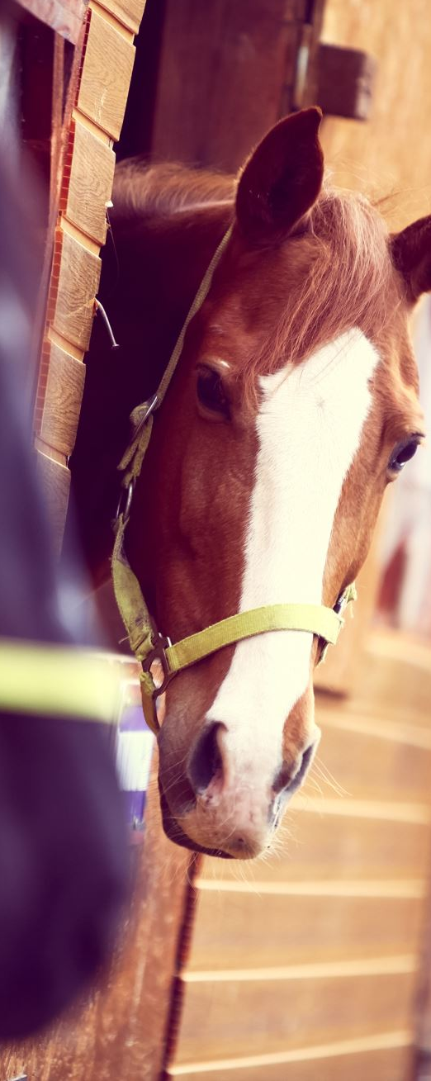
Industry Financial Position - continued
Process of how funds get distributed:
Industry funds get managed by the Horse Racing Industry Management Committee (HRIMC) and are split between:
Great Canadian Gaming Corporation as the operator of the two racetracks - Hastings Park and Fraser Downs.
Thoroughbred Racing Organizations – BCTOBA, CTHS BC and HBPA BC.
Standardbred Racing via Harness Racing BC (HRBC) which acts as the sole organization representing Harness Racing.
Notes:
Neil discussed the split and said that the split arrangement is currently in discussion for 2025 as this agreement expires at the end of 2024.

Slide 11
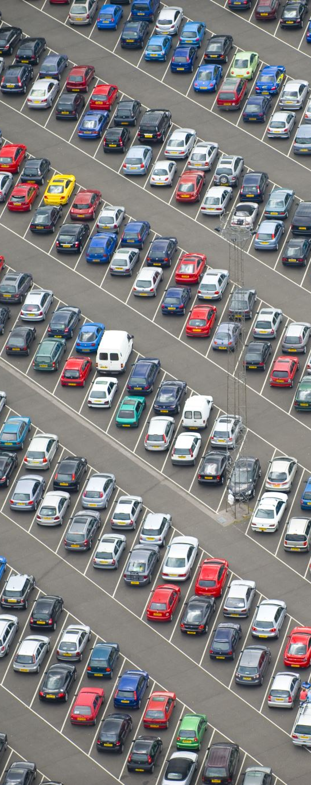
Industry Financial Position - continued
For 2023, to the end of December:
Industry funds to HRIMC, consisted of:
Slots Income $9,478,688
Racing Income $9,470,404 of a handle of $118,136,883
Total Income $18,949,092
This total then gets split to the three organizations noted previously. The split of this income is:
43.2% GCGC $8,186,008
33.635% Thoroughbreds $6,373,527
23.165% Standardbreds $4,389,557
Notes:
Numbers outlined to show how money flows, presented by Neil based on actual 2023 information.

Slide 12

Industry Financial Position - continued
For 2024, the following Income was budgeted:
For Thoroughbred Racing $6,373,174
- this was the 2023 actual and so it was used as the 2024 budget with the hope that slots would be better in 2024, and that TBC could continue its net revenue growth.
To October 2024, both slot and racing income have been less than 2023. Slots were 9.3% lower - $746,640 less and TBC’s income was 4.6% less - $396,057.
Total of $1,142,697 of which 33.625% ($384,232) is reduced Thoroughbred revenue – it is about roughly 25 races worth of revenue which is one reason why the 2024 race meet was adjusted by two days and some days with fewer races.
Notes:
Neil provided information as to what the 2024 budget was and what transpired during the year that impacted the amount of money the industry had to pay purses.

Slide 13

President’s Report – 2024 Meet
David Milburn, current and President-elect, to discuss:
2024 reduced days and races
Incentive Use – Fresh Horse (36), Wintering (100)
Communications – Newsletter
Vaccinations and tracking – role of Trainer and track Operator
New Board Members
Challenges for 2025
Notes:
David presented and discussed many topic areas:
On the 2024 meet – he repeated the reason for the reduction in race days.
He discussed funding of the incentive programs and how HBPA BC is supporting continuing these incentives in 2025, but funding is an issue.
He thanked Nigel and Denise in communications for improving member interaction. Nigel with the newsletter and Denise with government relations participation and with the trackside events that focused on owners and helping backstretch.
He said that government funding is important to get racing back to the level it can be as funding sources have reduced significantly in gross dollars and even more as a portion of BC budgeted funds since 2010 when the current plan was put in place. He sees this being addressed soon into the next mandate of the newly elected government.
Horse population and setting properly conditioned races with limited funds will be a challenge in 2025 but he feels a meet similar to 2024 can be had, if not bigger if new resources are provided.

Slide 14
TBC Discussion Areas
Budget – Expectations for 2024
Handle – Actuals and Forecasts
Promotions – 2024 and 2025
Notes:
Gary, as TBC chairperson, presented on behalf of Matthew Ruhlman of TBC who was not able to attend.

Slide 15
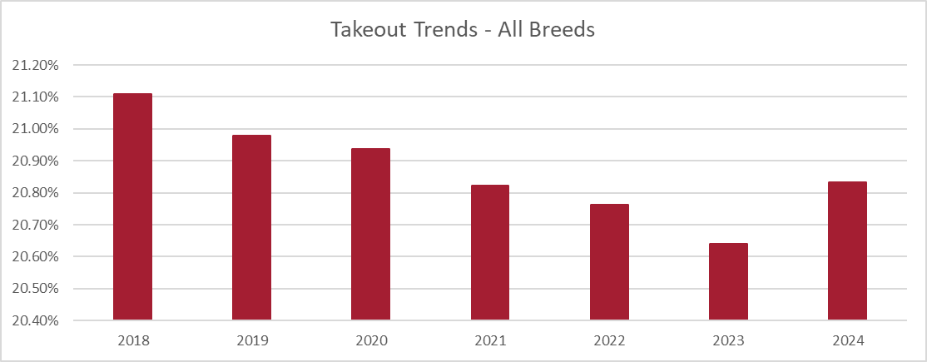
1. BUDGET
  Budget for 2024 was $116M
  Full year forecast is $115.8M
  Handle on par with 2023
Notes for year:
  Takeout changes on US simulcast
  Supporting promotions early in year with takeout changes
  Minimal impact on wagering in 2024
  Worked within budget to take advantage of opportunities
Notes:
Neil and Gary outlined how money flowed and took general questions from attendees.

Slide 16
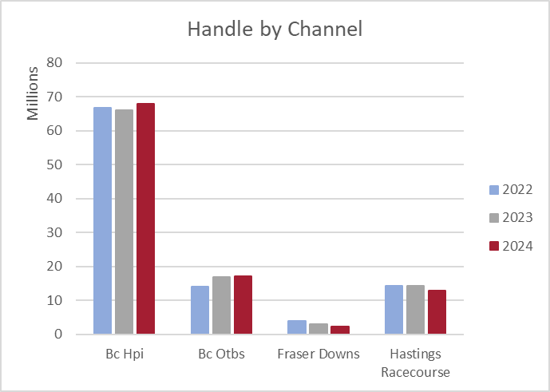
2. HANDLE (through Oct 2024)
  Total Wagering -0.5%
  BC HPI and OTBs +3.78%
  Tracks -9.9%
  Forecast is to match 2023
Notes for year:
  Increased takeout on almost all US tracks
  Commissions +0.23% or $195k even with lower handle
  Focused on Hong Kong and saw significant gains
  Negative breaks players affected net return to industry
Notes:
Gary outlined changes to key indicators over the past year and some general expectations for going forward.

Slide 17





3. PROMOTIONS
  Aggressive promotions on ADWs
  Regular coverage in DRF for Hastings
  Simulcast promotions through HPI
  DarkHorse Signup Blitzes (Highest to date)
  Ontrack events
2025 Promotion Objectives
  Expand simulcast promotions and offers through HPI
  Build on relationships and sponsorships with ADWs to drive handle and create awareness
Notes:
Gary commented on promotions planned and the role Great Canadian Entertainment has as the track operator in promoting racing events.

Slide 18
On-Going Matters and Issues
Lobbyist Work – Gary Johnson
Government Relations – Gary Johnson
Hastings Site Lease – David Milburn
Feedstore Storage – Neil Stajkowski
2025 Meet Details
  Race Dates – David
  Stall Applications and Vaccinations – David
  Feed Storage – Neil
  Incentives - David
Notes:
These items were discussed and presented at various points during the meeting. The site lease was stated to be due for renewal or extension in May 2026. Gary and David said that they have approached GCE for their comments on this to try to get information on their plans.
The recent issue that has just been brought to the attention of the HBPA was the possible complete closing of all feedstore storage areas. This matter may require the purchase of some additional containers to store feed store product.
2025 race schedule was discussed generally with the final dates expected to be announced in December.
Race incentives were discussed with the plan to go forward with the fresh horse program and likely the wintering program. Those are to be announced soon.

Slide 19
Other Business and Questions??

Slide 20
Adjournment
Time: _______________
Notes:
8:15 pm

